Slide 1
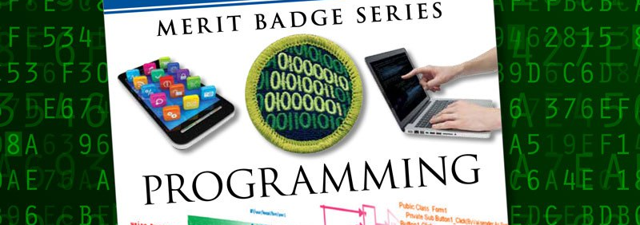
Programming
Merit Badge College 2018
Original slides by Eric Silva / Jessica Stodola @ https://github.com/jtstodola/BSA-Programming-Merit-Badge

Slide 2
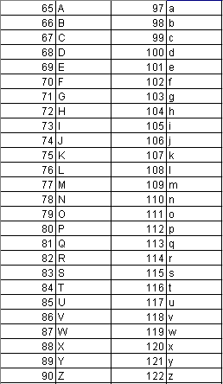
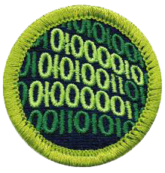
Hidden Message…
Notes:
Binary ASCII CODE

Slide 3
What is a Program?
Set of instructions
Tells a processor how to do a particular task

Slide 4
What is Programming?
Converting ideas into instructions
Understand the purpose of the program [Requirements]
Break instructions down into steps [Design]
Translate design into language [Coding]
Verify actual results match expected results [Testing]

Slide 5
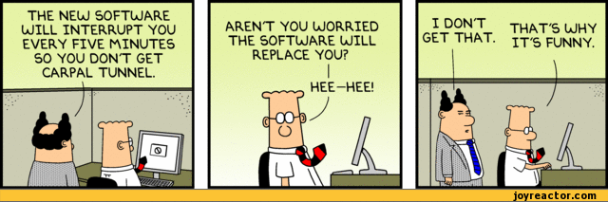
Safety
Repetitive Stress Injury (RSI)
Eyestrain
http://img1.joyreactor.com/pics/post/comics-dilbert-boss-dumb-574781.gif

Slide 7
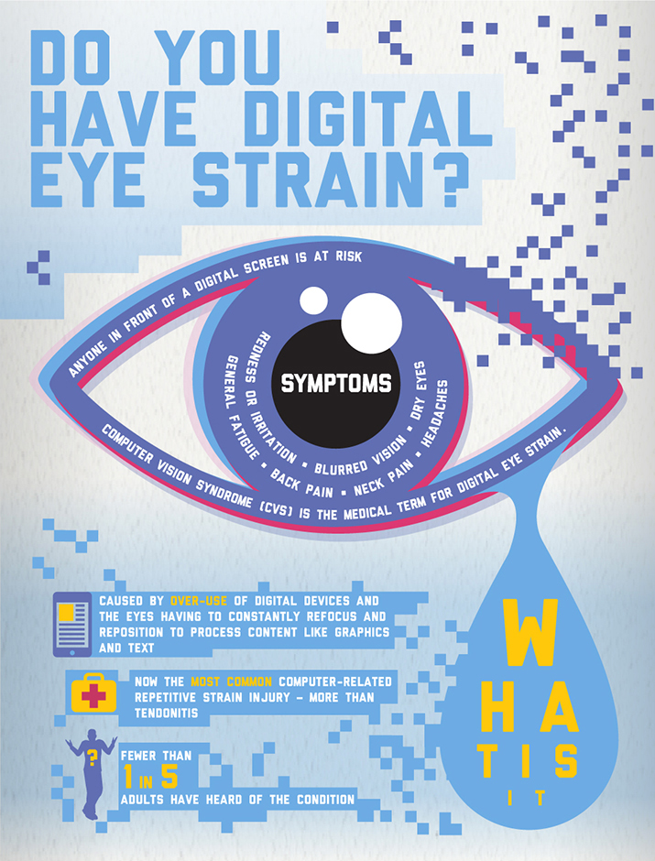
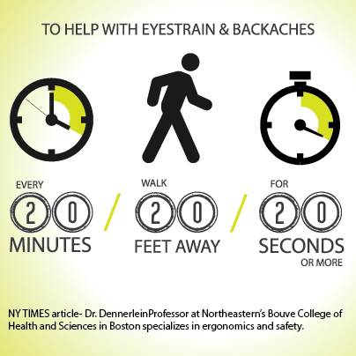
http://www.visionoptique.com/wp-content/uploads/sites/530/2015/12/vision-council-digital-eye-strain1.jpg
https://s-media-cache-ak0.pinimg.com/originals/c4/0d/ef/c40def66ef2156bacf90c7ad53ee069a.jpg

Slide 9

Take a Break
Eye breaks
Typing breaks
Rest breaks
Exercise breaks
http://www.mirci.org/wp-content/uploads/50-ways-to-take-a-break.jpg

Slide 10
History of Programming Languages
Jacquard Loom
Punch Cards

Slide 11
Ada Lovelace
1843
Ada Lovelace, a gifted mathematician, created the first computer programming language that wrote an algorithm for the Analytical Engine
(early mechanical computer)

Slide 12
Part of the Analytical Engine

Slide 13
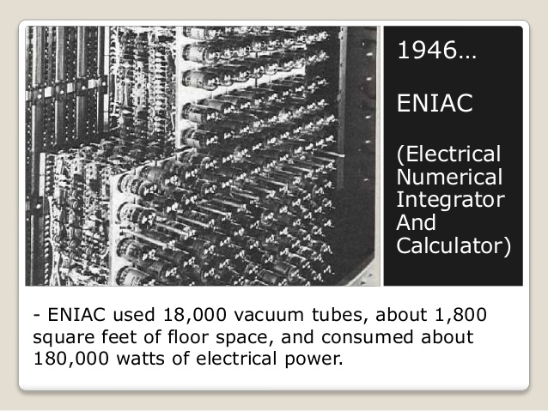
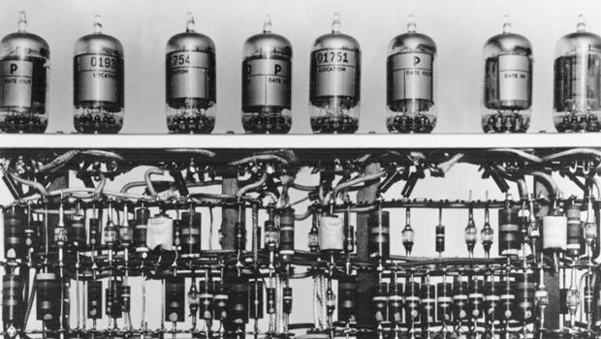
Early Computers
128 | 64 | 32 | 16 | 8 | 4 | 2 | 1
0 | 0 | 0 | 0 | 0 | 1 | 0 | 1
128 | 64 | 32 | 16 | 8 | 4 | 2 | 1
0 | 0 | 0 | 0 | 0 | 1 | 0 | 1
0 | 0 | 0 | 0 | 1 | 0 | 0 | 0
0 | 0 | 0 | 0 | 1 | 1 | 0 | 1
+
=
Notes:
Each vacuum tube could be on (1) or off (0) to represent numbers

Slide 14
John von Neumann
Conditional Control Transfer
If <condition> then <action a> else <action b>
if <raining> then <stay inside> else <go outside>
While <condition> do <action>
while <raining> do <hold umbrella>
subroutines, libraries, reusable code (functions & methods)
go outside:
stand up
walk to the door
open the door
walk out the door
close the door
Programming Pioneer
1903-1957
Notes:
Early innovator in game development

Slide 15
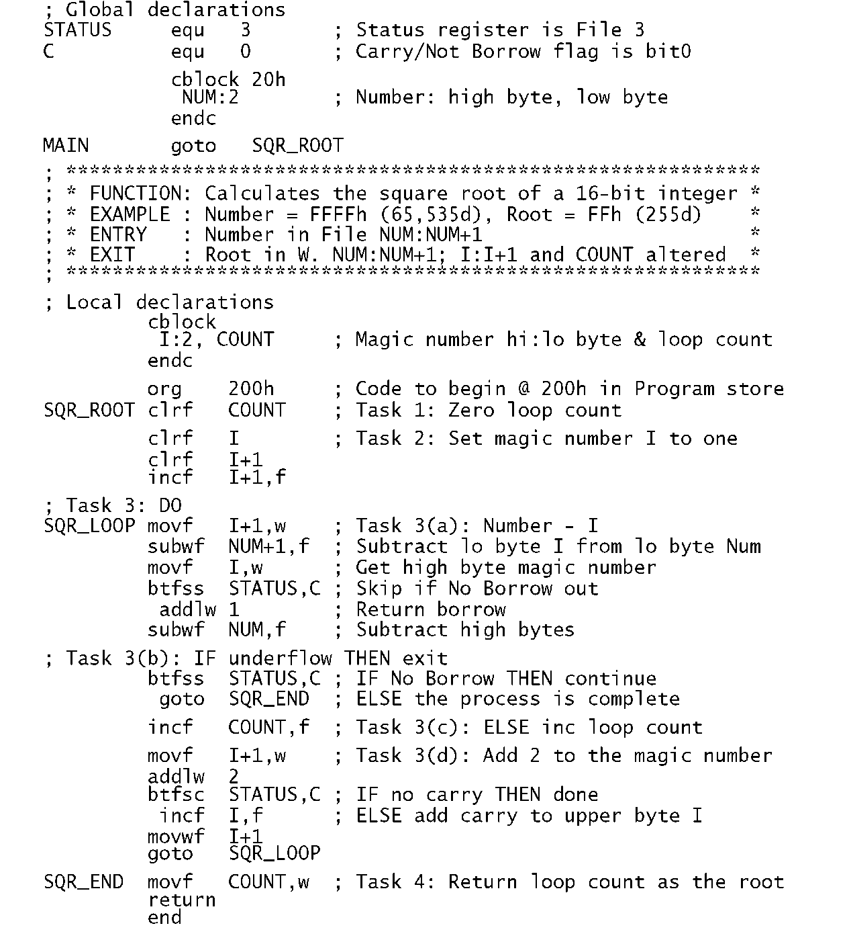
Assembly Language
Assembly language is hardware specific and is compiled into machine language (binary code)

Slide 16
High-Level Language
An advanced programming language
Easier for humans to understand
Not limited to single processor / machine

Slide 17
Early Important Languages
1950s
FORTRAN (1957)
John Backus (IBM)
Formula Translating System
High performance computing – weather and climate modeling
Computationally intensive
LISP (1958)
John McCarthy (MIT)
Recursion and list-processing
Artificial intelligence
COBOL (1959)
Common Business Oriented Language
Primarily used in business, finance, and admin systems
1960s-1970s
BASIC (1964)
John Kemeny and Thomas Kurtz (Dartmouth)
Beginner’s All-purpose Symbolic Instruction Code
Based on FORTRAN II
Pascal (1970)
Niklaus Wirth
Developed to encourage good programming practices
Structured programming
Data Structuring
C (1972)
Dennis Ritchie (AT&T Bell Labs)
Developed to implement Unix OS
One of the most widely used programming languages

Slide 18
Object-Oriented Programming
Different than procedural programming
Logical grouping / modularization of commands
Allows for re-use
Simula (1960s)
Smalltalk (1970s)
C++ (1983)
Java (1995)

Slide 20
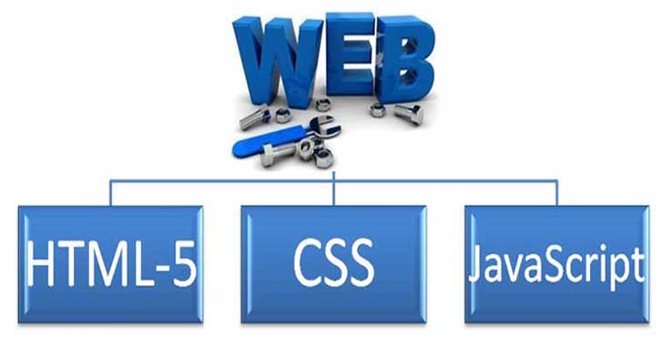
The World Wide Web
<html xmlns="http://www.w3.org/1999/xhtml">
<head>
<meta name="keywords" content="Programming,MeritBadge,Scouts" />
<link rel="shortcut icon" href="/wiki/favicon.ico" />
<title>Programming - MeritBadgeDotOrg</title>
<style type="text/css" media="screen, projection">
a { font-face: Helvetica; font-size: 16pt; }
.doc-body { background-color: green; }
#scoutStuff { border-width: 5px; height: 100px; }
</style>
<script language="JavaScript" type="text/javascript">
function newImage(arg) {
if (document.images) {
rslt = new Image();
rslt.src = arg;
return rslt;
}
}
</script>
</head>
<body>
<table> <!-- comments look like this -->
<tr>
<td>some info here</td>
<td>a second column</td>
</tr>
<tr>
<td>More info</td>
<td>blah, blah, blah...</td>
</tr>

Slide 21
Other Programming Languages
ADA (1980)
US Department of Defense and UK Ministry of Defense
Wanted standardized language
Objective-C (1983)
Apple programming OSX and iOS
PERL (1987)
Python (1991)
Official language of Raspberry Pi
Ruby (1993)
Web application development
SQL (Structured Query Language)
Database language
Java (1995)
Android development
PHP (1995)
WordPress, Drupal
>81% of all websites
JavaScript (1995)
Dynamic web pages
C# (2000)
Dynamic web pages
Elixir (2012)
Dynamic web pages
Ladder Logic (PLC)
Factory/Machinery Control

Slide 23
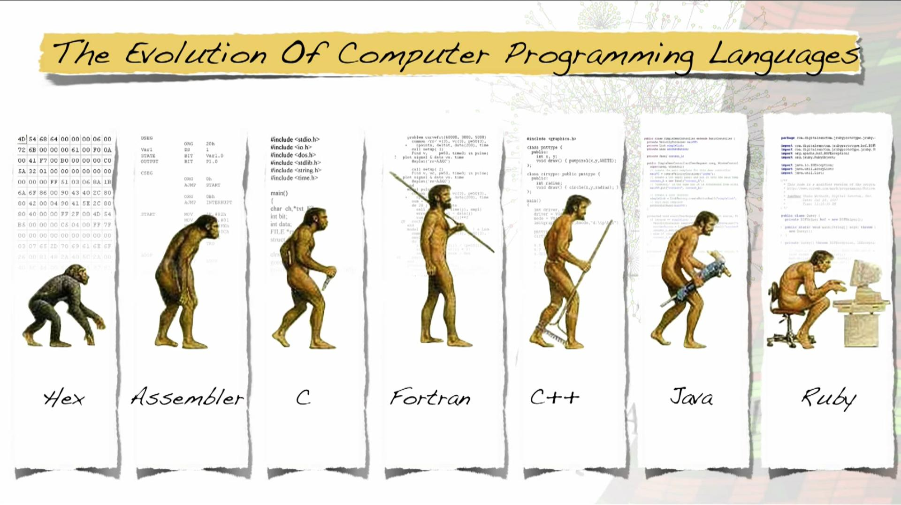

Slide 24
Where is Programming Used?

Slide 25

Programmed Devices
Mobile Phones
Tablets
DVD / Blu-ray
Game Consoles
Alarm Clock
TV / DVR
Cars
Watch
Fitness Trackers
GPS
Coffee Pot
Microwave

Slide 26
Business Applications
Retail
Point-of-sale systems
Receipt printers
Card readers
Cash drawers
Warehouses
Inventory control
Temperature control
Accounting
Accounting systems to track money
May be integrated with point-of-sale and inventory systems
Administrative
Communication systems
Word processing
Spreadsheet applications

Slide 27
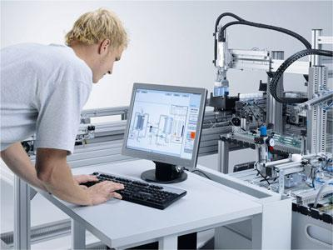
Factory Automation
Programmable Logic Controller (PLC)
Designed specifically to control machines
Machines themselves are not programmed
Can be programmed to do the same task over and over again
Durable
Work in wide temperature ranges
Work in harsh conditions
http://www.leventparali.com.tr/files/page/4d4518f294.jpg

Slide 28
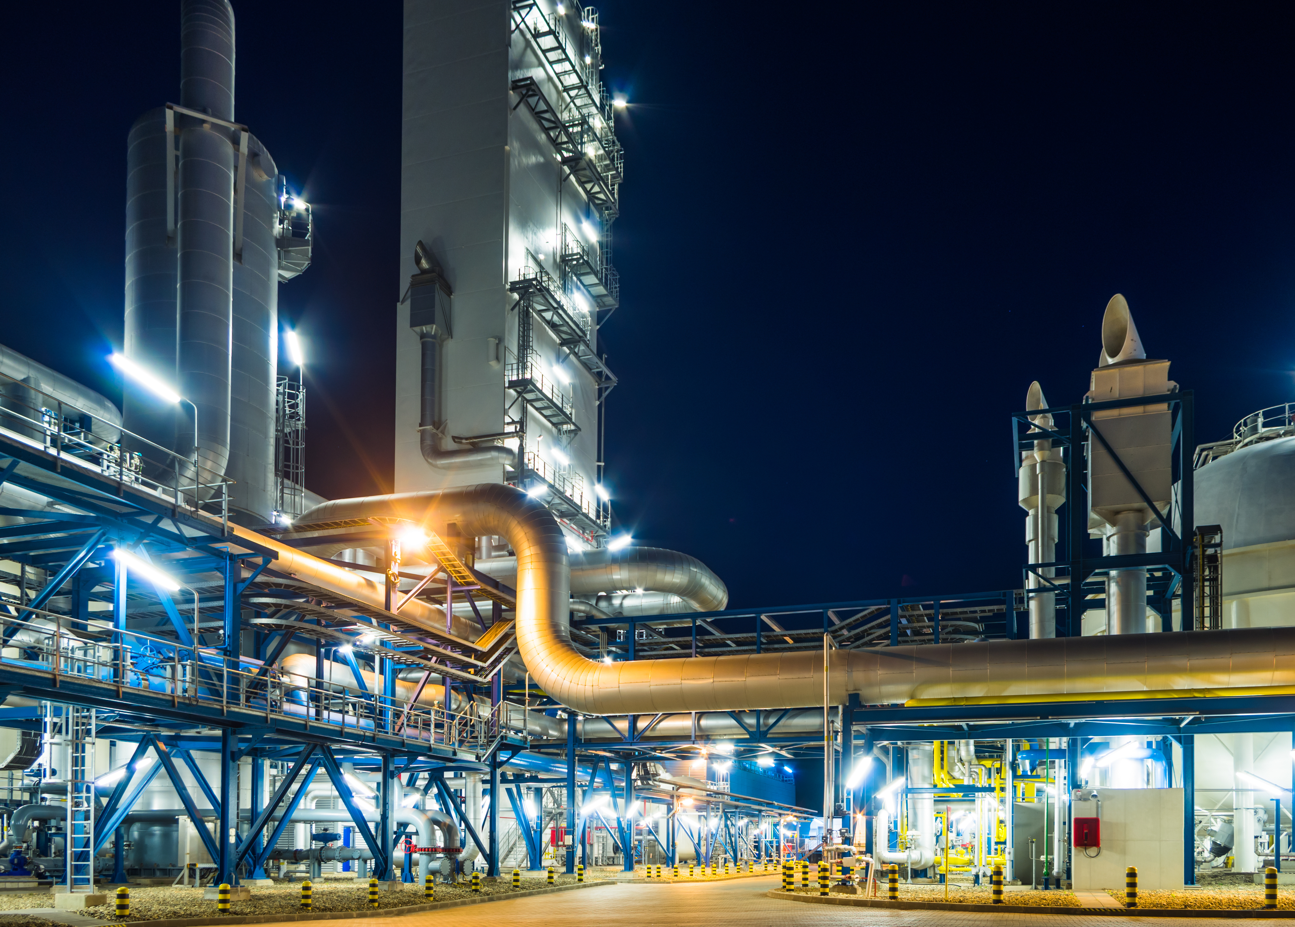
History of PLCs
Factories were controlled by relays; on or off
Lights
Conveyor Belts
Fans
Ovens
Hundreds and thousands may be used
Cabinets full of relays and wires
Bulky and hard to fix
Changing process was hard; required re-wiring
Modular Digital Controller (MODICON; late 1960s)
Simple computer; replaced relays

Slide 29
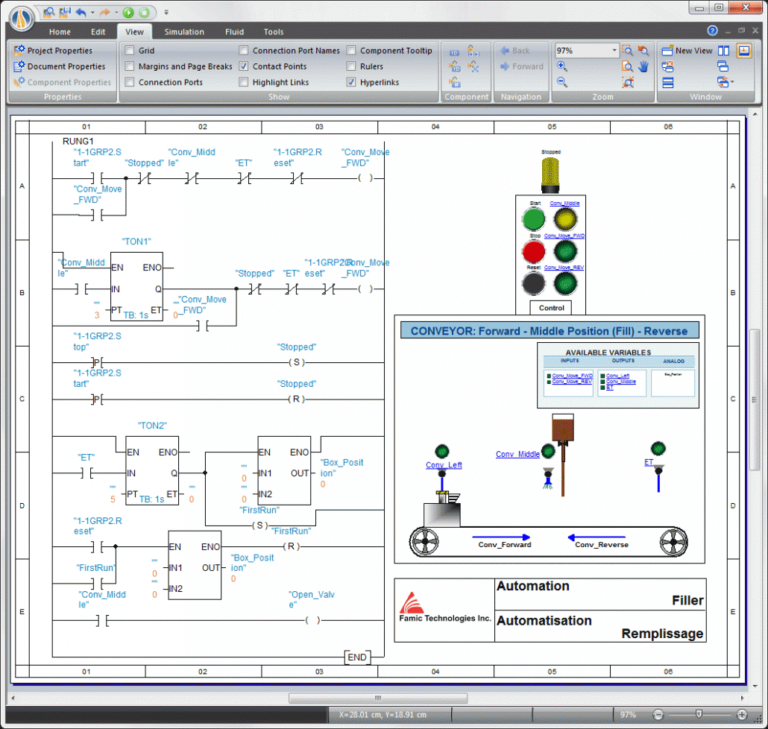
Programming PLCs
Different than other kinds of programming
Several ways to be programmed
Ladder Logic – most popular
Resembles a relay wiring diagram
True = 1 = input energized.
False = 0 = input NOT energized.
http://www.clxengineering.com/wp-content/uploads/2014/10/PLC-Ladder-Logic-Change-Name-1030x978.gif

Slide 30
Where else can we use Programming?

Slide 31


Slide 32
Web Applications

Slide 33
Databases

Slide 34
Structured Query Language (SQL)
Data Definition Language (DDL)
Definition of database structure
Data access control
Data Manipulation Language (DML)
Query language to create, read, update, and delete (CRUD)
SELECT
INSERT
UPDATE
DELETE

Slide 35

http://cms.ipressroom.com.s3.amazonaws.com/173/files/20147/53e26cc26eafb5045a000080_Intellectual+property/Intellectual+property_mid.jpg

Slide 36

https://media.licdn.com/mpr/mpr/shrinknp_800_800/AAEAAQAAAAAAAAZ2AAAAJGM4MGIxYTM5LWVlMjYtNDYyMS1hZWUyLTk2MTAyZTA0ZmE1NA.png

Slide 37
Copyrights
Protects a particular expression of an idea
Automatically available once idea is created and physically stored
Protects against others making copies of images, code, etc.

Slide 38
Patents
Protects useful and innovative:
Processes or methods
Machines
Manufactured items
Not automatic. Must be applied for with the US Patent and Trademark office
Lengthy process; often requires services of a patent attorney or agent

Slide 39

Trade Secrets
Protects commercially valuable information
Owner has taken strong measures to maintain secrecy
Does not protect against the use if developed independently or if information was acquired legitimately
http://teganblackburn.com/wp-content/uploads/2016/10/trade-secrets-pic.png

Slide 40

Understanding the Differences
OPEN SOURCE
Source code:
Available to public
Modifiable
May be redistributed
Community of developers
Free
Support can be community based or paid
Open Source Initiative (opensource.org)
Github.com (source of these slides)
FREEWARE
Free
Developer chooses free distribution
Source code not available
Distribution from developer site only
SHAREWARE
Free for limited/trial period
Developer owns rights
Source code not available
No collaborative community
Payment often required

Slide 41
What does a programmer do?
Software Developer
Database Developer
Security Specialist
User Interface Designer
Quality Tester (QA)
Writes programs for web, mobile, PCs, cars, robots, games, etc.
Writes programs to get and manage information
Uses programming and other methods to find security problems
Creates pictures, buttons, etc. so programs are easier to use
Creates tests for programs, to make sure they have no errors

Slide 42
Would you like to be a Programmer?
Do you enjoy using computers for a long time?
Are you very careful about getting little details right?
Can you stay focused on a big task until it’s done?
Are you good at solving math problems?
Do you like learning the details of how things work?
Are you patient when working on hard problems and slow to give up?
Do you like solving puzzles and figuring things out without instructions?

Slide 43
How do you get to be a Programmer?
Study Math (especially algebra)
Play creative games that require complex thinking, strategy or programming
Example: making complex things in Minecraft using Redstone
College degree in Computer Science preferred
Practice solving brain teasers and logic puzzles
Start writing your own computer code!
Search for help and project ideas on the Internet

Slide 44
Programming Resources
Code Academy: codecademy.com
Code.org: code.org
Learn Python: learnpython.org
Learn C#.NET: microsoft.com/net/learn/
Killer PHP: killerphp.com
W3 Schools: w3schools.com
Tutorials Point: tutorialspoint.com
Scratch: scratch.mit.edu
JavaScript Fiddle: jsfiddle.net
Repl.It (multiple languages): REPL.it

Slide 45
Contact Info
Your Name Here
you@mail.com
(###) ###-####

